Slide 1
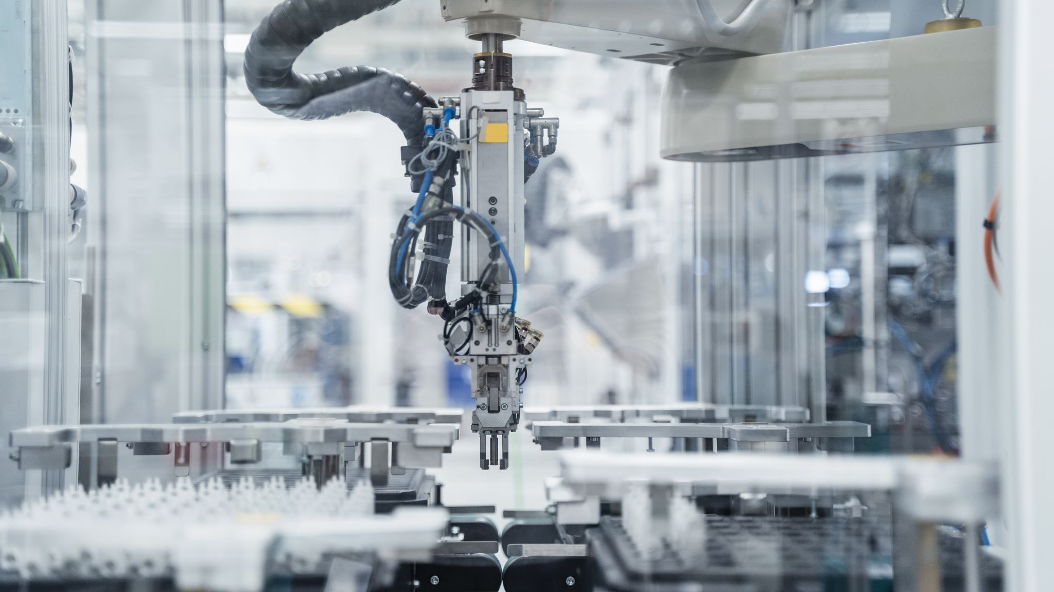
AI-Powered Predictive Maintenance System for Industrial Equipment
By: Olugbenga Adegoroye, Richard Evans, Miguel Mora, and Akinbobola Akinpelu.
Course: ITAI2277 Fall 2025
Professor: Sitaram Ayyagari

Slide 2
Our Goal
Problem:
Machines often fail unexpectedly, causing downtime and high repair costs.
Current maintenance methods are either too late or too frequent.
Our goal:
Predict failures before they happen using Artificial Intelligence.
The system will help save money, reduce downtime, and improve safety.

Slide 3

Solution Outline
We use AI to analyze machine sensor data like a “health check.”
The model predicts the Remaining Useful Life (RUL) of equipment.
A dashboard shows clear alerts and easy-to-read graphs.
The solution is scalable and designed for businesses.

Slide 4
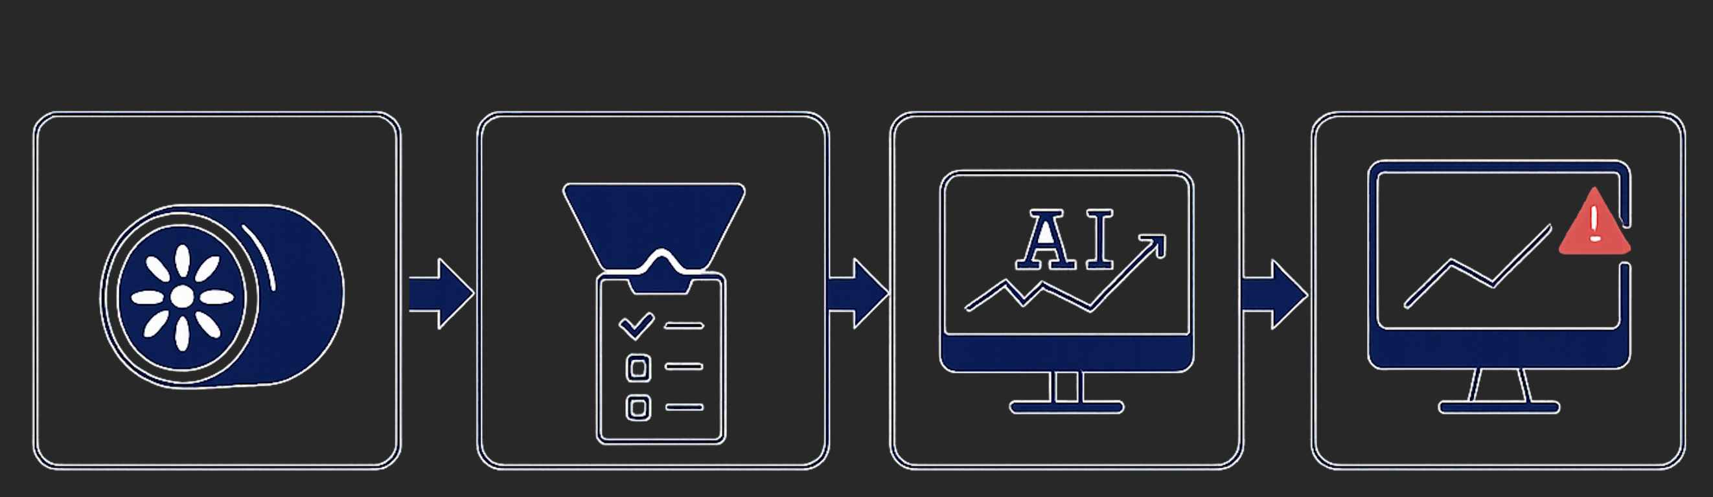
ML Process Flow
Collect real-world turbofan engine data from NASA.
Clean and prepare the data for analysis.
Train AI models to learn patterns of machine degradation.
Deploy predictions to a dashboard for real-time monitoring.

Slide 5


Technology Stack: Core Modeling and Tools
Random Forest Classifier predicts binary failures in less than 30 cycles.
LSTM Neural Network learns time-series patterns for RUL prediction.
Visualization: Matplotlib and Seaborn for plots and sensor analysis.

Slide 6

Technology Stack: Front-End and Dashboard
Streamlit Dashboard provides real-time monitoring and alerts.
Displays Remaining Useful Life curves and failure probabilities.
Integrates SHAP explainability to highlight sensor importance.
SHAP (SHapley Additive exPlanations) is a method that explains ML predictions by showing how each feature contributes to the outcome.
Designed for easy use by non-technical operators.

Slide 7

Technical Stack: Hardware and Environment
Built and tested in the Google Colab cloud environment.
TensorFlow 2.19 and Pandas 2.2.2 ensure compatibility.
Runs efficiently on standard CPUs and GPUs.
Scalable design for industrial deployment.

Slide 8

Demo of the Product
Input: Sensor readings from industrial equipment.
Output: AI predicts Remaining Useful Life in hours or cycles.
Dashboard shows alerts and degradation curves.
Users can act before breakdowns occur.
https://github.com/DrahcirSnave/Predictive-Maintenance-Capstone

Slide 9

Libraries
NumPy and Pandas for data handling.
Scikit-learn for Random Forest classification.
TensorFlow/Keras for LSTM regression.
SHAP for explainability.
Matplotlib and Seaborn for visualization.

Slide 10
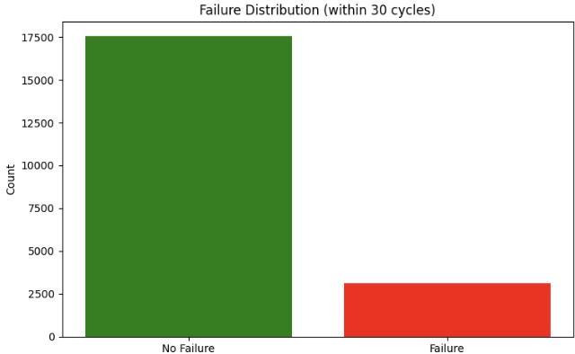
Data Preprocessing
Removed constant sensors with no variation.
Engineered features: rolling mean, rolling standard deviation(std), rate of change.
Created binary failure labels within 30 cycles.
Normalized features using MinMaxScaler.

Slide 11
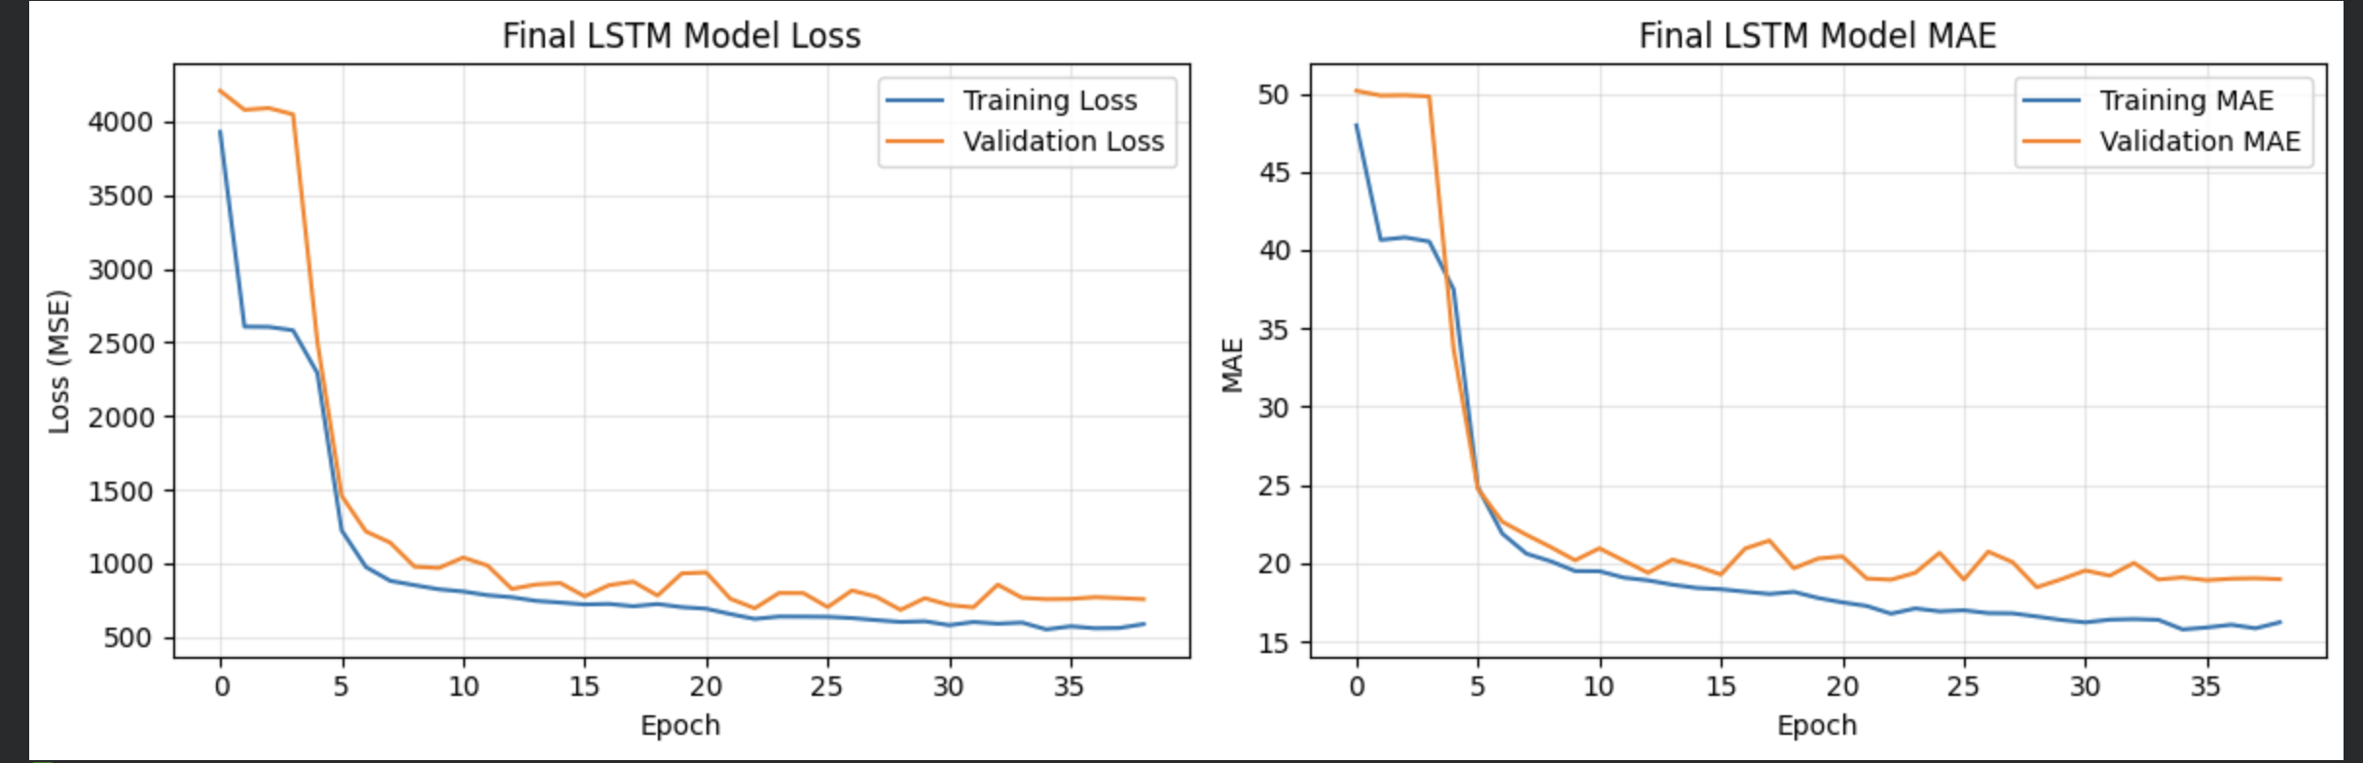
Model Training
Random Forest classifier trained for binary outcomes.
LSTM trained on sequences for RUL prediction.
EarlyStoppping used to prevent overfitting.
Evaluation with accuracy, precision, recall, and F1.

Slide 12
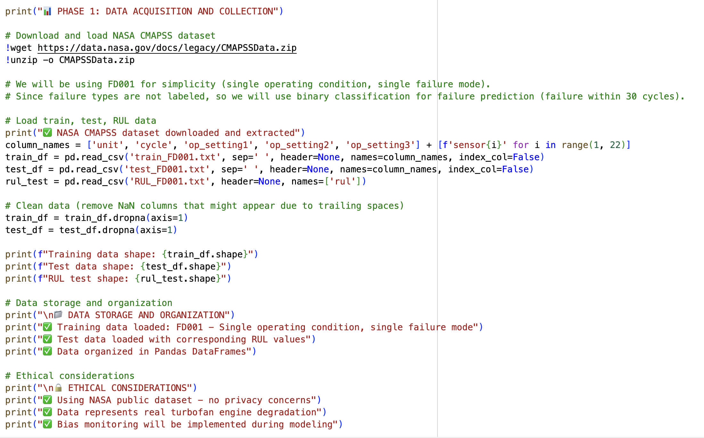
Code Walkthrough
Data acquisition from the NASA CMAPSS dataset.
Preprocessing pipeline with feature engineering.
Training loop and evaluation metrics.

